Slide 1
CCE201: Solid State Electronic Devices
EEC223: Electronics (1)
Lecture 08 Field Effect Transistors (1)
Prepared By
Dr. Eng. Sherif Hekal
Assistant Professor, CCE department

Slide 2
Introduction
IN THIS LECTURE WE WILL LEARN
General overview on FET transistor and its types.
The physical structure of the MOS transistor and how it works.
How the voltage between two terminals of the transistor control the current that flows through the third terminal, and the equations that describe these current-voltage characteristics.
How the transistor can be used to make an amplifier, and how it can be used as a switch in digital circuits.

Slide 3
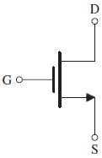
Introduction
Q: What, in simplest terms, is the desired operation of a three-terminal device?
A: Employ voltage between two terminals to control current flowing in to the third.
+
V_{GS}
-

Slide 4
Introduction
note: MOSFET is more widely used in implementation of modern electronic devices
Q: What are two major types of three-terminal semiconductor devices?
metal-oxide-semiconductor field-effect transistor (MOSFET)
bipolar junction transistor (BJT)
Q: Why are MOSFET’s more widely used?
size (smaller)
ease of manufacture
lesser power utilization
MOSFET technology
It allows placement of approximately 2 billion transistors on a single IC
backbone of very large scale integration (VLSI)
It is considered preferable to BJT technology for many applications.
Notes:
Note that MOSFETs are more recent development than Bipolar transistors.
Bipolar transistors were just beginning to be covered in EE curricula when I was in school (early 1960’s).
There was no mention of MOSFETS in that period.

Slide 5
Differences between FET & BJT
 | Field Effect Transistor (FET) | Bipolar Junction Transistor (BJT)
1 | Unipolar Current depends only on one type of carriers | Bipolar Current depends on both electrons and holes
2 | Voltage controlled device | Current controlled device
3 | Very high input impedance | Low input impedance
4 | Simpler in fabrication and occupies less space in integrated form | occupies large space in integrated form
5 | Low voltage gain High current gain | High voltage gain Low current gain
6 | Easily damaged | Robust

Slide 6
Field Effect Transistor (FET)
The name Field Effect Transistor arises from the fact that the current flows between two terminals “Drain (D) & Source (S)” is controlled by an electric field which is applied on the third terminal “Gate (G)”
FET
J-FET
MOSFET
D-MOSFET
E-MOSFET

Slide 7
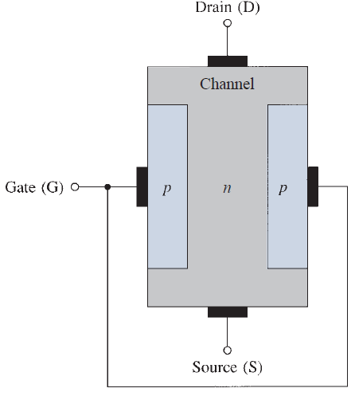
Junction Field Effect Transistor (J-FET)
Physical Structure (n-channel)
It consists of bar of n-type silicon with p-type silicon diffused on both sides, each “p” region is called gate. In most cases, the two gates are internally connected and the device acts like a single gate
Source (S): is the terminal through which the majority carriers enter the channel.
Drain (D): is the terminal through which the majority carriers leave the channel.
Channel: the region of n-type material between the drain and source terminals.

Slide 8
Junction Field Effect Transistor (J-FET)
Biasing of N-channel JFET
The drain terminal should be +ve relative to the source
The gate terminal should be -ve relative to the source

Slide 9
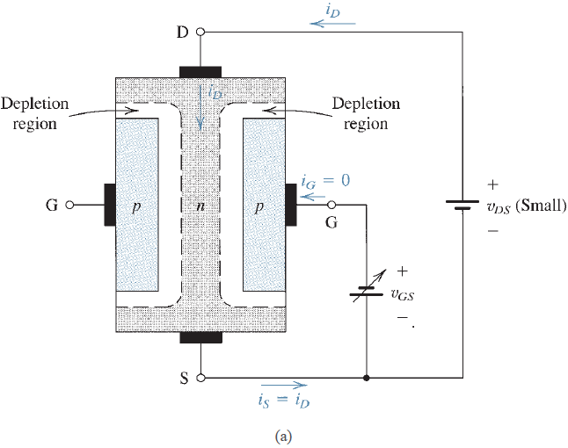
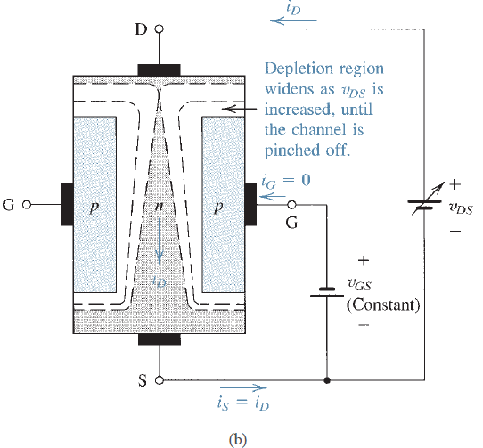
Junction Field Effect Transistor (J-FET)
Physical operation of the n -channel JFET:
(a) For small $V_{DS}$the channel is uniform and the device functions as a resistance whose value is controlled by $V_{GS}$(more $V_{GS}$in negative → larger depletion region → narrower channel → lower current $I_{D}$)
(b) Increasing $V_{DS}$ causes the channel to acquire a tapered shape and eventually pinch-off occurs, so the current reaches the max value $I_{DS}$. If $V_{GS}=0$ ➔the max value is $I_{DSS}$

Slide 10
Junction Field Effect Transistor (J-FET)
$$V_{DG}<−V_{p}$$
$$V_{DG}≥−V_{P}$$
Active (Pinch-off) region
Triode
$$I_{DSS}$$
Triode
Transfer Characteristics
V-I Characteristics
$$V_{GS}≤−V_{P}$$

Slide 11
Junction Field Effect Transistor (J-FET)
Gate control
$$\left|V_{GS}\right|<\left|V_{P}\right|$$
|𝑉_𝐺𝑆 |<|𝑉_𝑃 |
Triode region if
$$\left|V_{DG}\right|<\left|V_{P}\right|$$
Triode region if
|𝑉_𝐷𝐺 |<|𝑉_𝑃 |
Pinch-off region if $\left|V_{DG}\right|≥\left|V_{P}\right|$
Pinch-off region if |𝑉_𝐷𝐺 |≥|𝑉_𝑃 |
$$\left|V_{GS}\right|≥\left|V_{P}\right|$$
|𝑉_𝐺𝑆 |≥|𝑉_𝑃 |
Cut-off region
$$I_{D}=0$$
Cut-off region
𝐼_𝐷=0
$V_{P}$is the pinch-off voltage

Slide 12
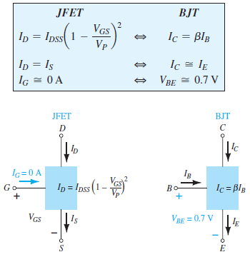
Equations in active region
$I_{D}=$drain current
$I_{C}=$Collector current
$I_{S}=$Source current
$I_{E}=$Emitter current
$I_{DSS}$is the maximum drain current for a JFET and is defined by the conditions $V_{GS}=0 V$ and $V_{DG}≥|V_{P}|$.

Slide 13
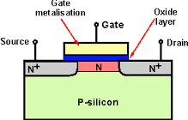
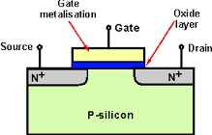
Difference between JFET & MOSFET
D-MOSFET
Depletion type
E-MOSFET
Enhancement type
J-FET
The key difference between JFET and MOSFET is that the gate terminal in MOSFET is insulated from the channel. Because of this insulated gate, the input impedance of a MOSFET is many times higher than that of a JFET.

Slide 14
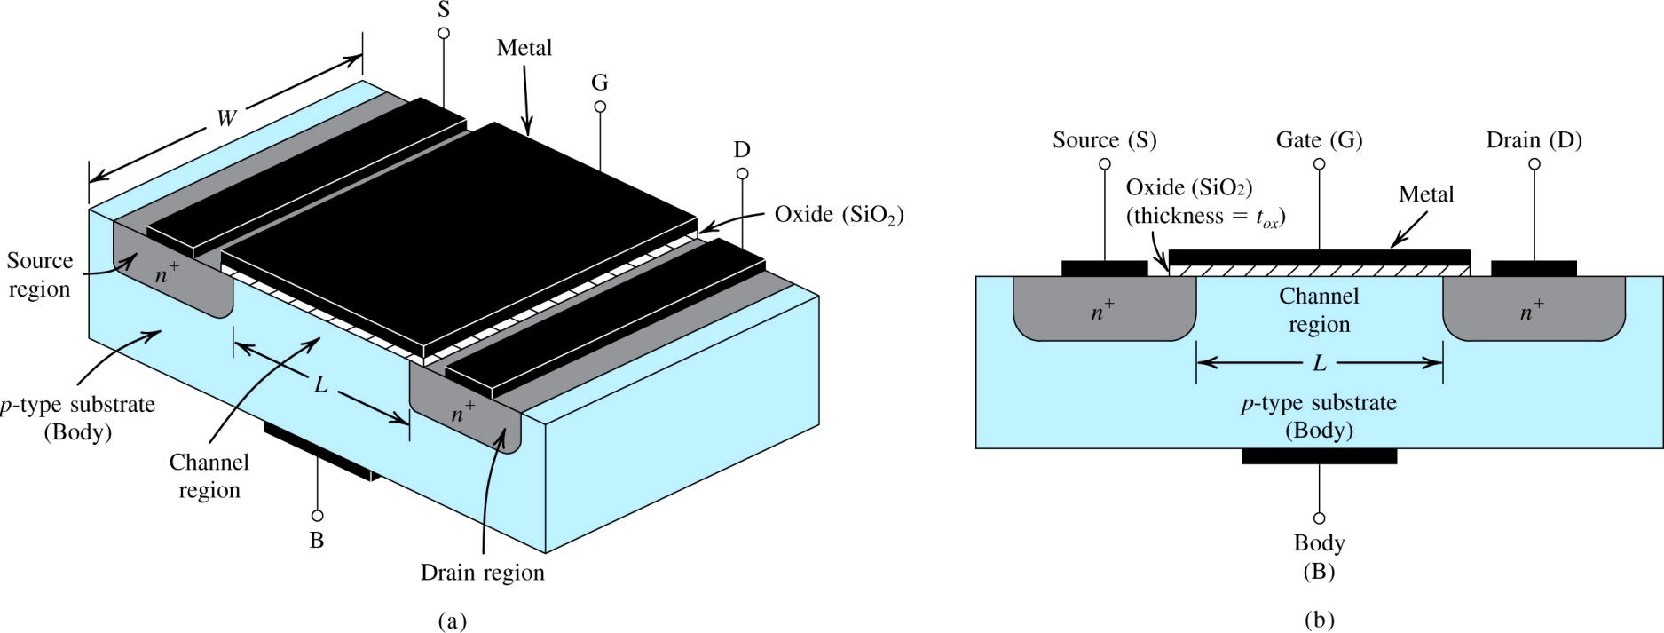
1. Device Structure and Operation
Figure 1: Physical structure of the enhancement-type NMOS transistor: (a) perspective view, (b) cross-section. Note that typically L = 0.03um to 1um, W = 0.1um to 100um, and the thickness of the oxide layer (t_{ox}) is in the range of 1 to 10nm.
Notes:
Enhancement mode vs. Depletion Mode devices differ in their Gate voltage characteristics.

Slide 15
1. Device Structure and Operation
two n-type doped regions (drain, source)
layer of SiO₂ separates source and drain
metal, placed on top of SiO₂, forms gate electrode
one p-type doped region
Figure 1: Physical structure of the enhancement-type NMOS transistor: (a) perspective view, (b) cross-section. Note that typically L = 0.03um to 1um, W = 0.1um to 100um, and the thickness of the oxide layer (t_{ox}) is in the range of 1 to 10nm.
Notes:
The IC substrate is “diode isolated”

Slide 16
1. Device Structure and Operation
The name MOSFET is derived from its physical structure.
However, many MOSFET’s do not actually use any “metal”, polysilicon is used instead.
“This” has no effect on modeling / operation as described here.
Another name for MOSFET is insulated gate FET, or IGFET.
The device is composed of two pn-junctions, however they maintain reverse biasing at all times.
Drain will always be at positive voltage with respect to source.
We will not consider conduction of current in this manner.

Slide 17
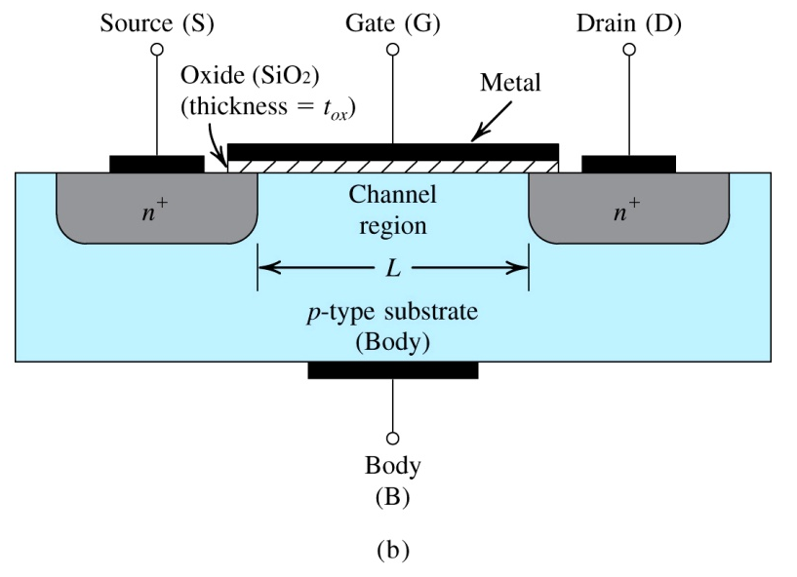
1.2. Operation with Zero Gate Voltage
With zero voltage applied to gate, two back-to-back diodes exist in series between drain and source.
“They” prevent current conduction from drain to source when a voltage v_{DS} is applied.
yielding very high resistance (10¹²ohms)
Physical structure of MOSFET

Slide 18
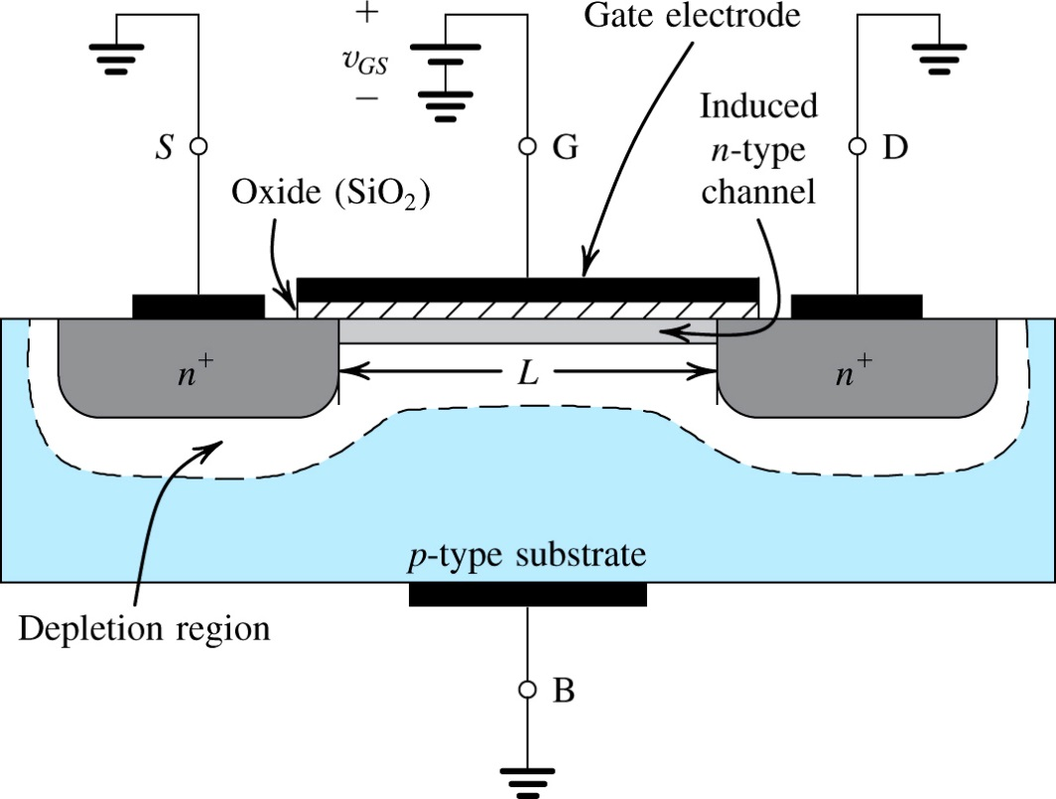
1.3. Creating a Channel for Current Flow
Q: What happens if (1) source and drain are grounded and (2) positive voltage is applied to gate? Refer to figure to right.
step #1: v_{GS} is applied to the gate terminal, causing a positive build up of positive charge along metal electrode.
step #2: This “build up” causes free holes to be repelled from region of p-type substrate under gate.
Figure 2: The enhancement-type NMOS transistor with a positive voltage applied to the gate. An n channel is induced at the top of the substrate beneath the gate

Slide 19
Q: What happens if (1) source and drain are grounded and (2) positive voltage is applied to gate? Refer to figure to right.
step #3: This “migration” results in the uncovering of negative bound charges, originally neutralized by the free holes
step #4: The positive gate voltage also attracts electrons from the n⁺ source and drain regions into the channel.
Figure 2: The enhancement-type NMOS transistor with a positive voltage applied to the gate. An n channel is induced at the top of the substrate beneath the gate
Notes:
Negative charge concentration is “enhanced” by a positive voltage on the gate.
This creates an induced channel for current flow between the Drain and the Source regions.
I am always bothered by the naming convention as current flows from the drain to the source. ☹

Slide 20
Q: What happens if (1) source and drain are grounded and (2) positive voltage is applied to gate? Refer to figure to right.
this induced channel is also known as an inversion layer
step #5: Once a sufficient number of “these” electrons accumulate, an n-region is created…
…connecting the source and drain regions
step #6: This provides path for current flow between D and S.
Figure 2: The enhancement-type NMOS transistor with a positive voltage applied to the gate. An n channel is induced at the top of the substrate beneath the gate

Slide 21
1.3. Creating a Channel for Current Flow
threshold voltage (V_{t}) – is the minimum value of v_{GS} required to form a conducting channel between drain and source
typically between 0.3 and 0.6V_{dc}
field-effect – when positive v_{GS} is applied, an electric field develops between the gate electrode and induced n-channel – the conductivity of this channel is affected by the strength of field
SiO₂ layer acts as dielectric
effective / overdrive voltage – is the difference between v_{GS} applied and V_{t}.
oxide capacitance (C_{ox}) – is the capacitance of the parallel plate capacitor per unit gate area (F/m²)
(Eq. 1)
(Eq. 2)
Notes:
SiO₂ is glass!

Slide 22
1.3. Creating a Channel for Current Flow
Q: What is main requirement for n-channel to form?
A: The voltage across the “oxide” layer must exceed V_{t}.
For example, when v_{DS} = 0…
the voltage at every point along channel is zero
the voltage across the oxide layer is uniform and equal to v_{GS}
Q: How can one express the magnitude of electron charge contained in the channel?
A: See below…
Q: What is effect of v_{OV} on n-channel?
A: As v_{OV} grows, so does the depth of the n-channel as well as its conductivity.
(Eq. 3)

Slide 23
1.4. Applying a Small v_{DS}
Q: For small values of v_{DS}, how does one calculate i_{DS} (aka. i_{D})? A: Equation (4)…
Q: What is the origin of this equation?
A: Current is defined in terms of charge per unit length of n-channel as well as electron drift velocity.
(Eq. 4)

Slide 24
1.4. Applying a Small v_{DS}
Q: What is observed from equation (4)?
A: For small values of v_{DS}, the n-channel acts like a variable resistance whose value is controlled by v_{OV}.
(Eq. 5)
(Eq. 6)
Notes:
MOSFETs are voltage controlled resistors!

Slide 25
1.4. Applying a Small v_{DS}
Q: What three factors is r_{DS} dependent on?
A: process transconductance parameter for NMOS (μ_{n}C_{ox}) – which is determined by the manufacturing process
A: aspect ratio (W/L) – which is dependent on size requirements / allocations
A: overdrive voltage (v_{OV}) – which is applied by the user

Slide 26
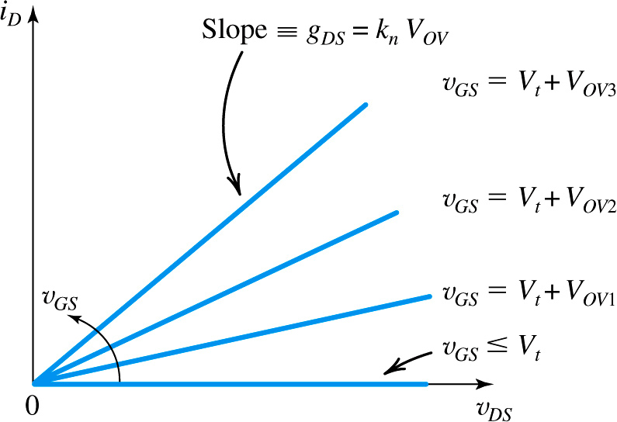
k_{n} is known as NMOS-FET transconductance parameter and is defined as μ_{n}C_{ox}W/L
1/r_{DS}
low resistance, high v_{OV}
high resistance, low v_{OV}
Figure 4: The i_{D}-v_{DS} characteristics of the MOSFET in Figure 5.3. when the voltage applied between drain and source V_{DS} is kept small.

Slide 27
1.5. Operation as v_{DS} is Increased
Q: What happens to i_{D} when v_{DS} increases beyond “small values”?
A: The relationship between them ceases to be linear.
Q: How can this non-linearity be explained?
step #1: Assume that v_{GS} is held constant at value greater than V_{t}.
step #2: Also assume that v_{DS} is applied and appears as voltage drop across n-channel.
step #3: as v_{DS} is Increased, the depletion layer, between p-type (body) and n-type (channel) near the drain, increases and so the cross section area of the channel near the drain decreases as shown in Fig. 5. Hence as v_{DS} is Increased, the current slowly increased (nonlinear relation) and this region is called near pinch-off.
When v_{DS} > v_{ov} , the channel near the drain completely pinched-off and the current flows in the channel saturates (reach to the maximum value). This region is called pinch-off “Saturation” or “active”.

Slide 28
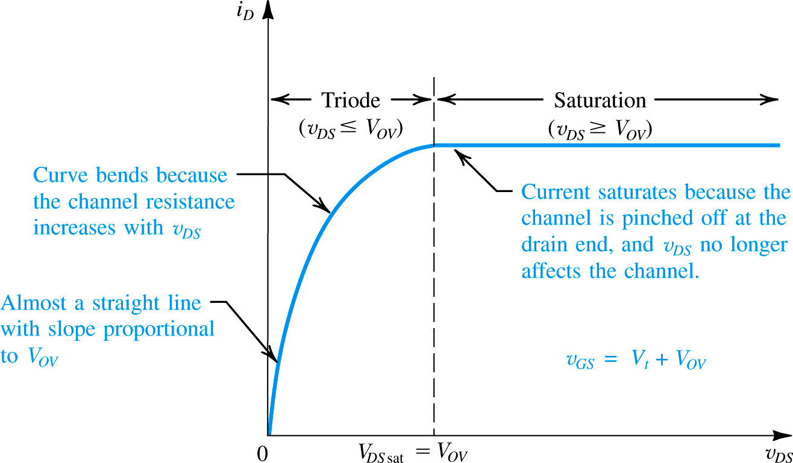
saturation occurs once v_{DS} > v_{OV}
(Eq. 7)

Slide 29
Example 1: NMOS MOSFET
Example 5.1. Problem Statement: Consider an NMOS process technology for which L_{min} = 0.4mm, t_{ox} = 8nm, μ_{n} = 450cm²/Vs, V_{t} = 0.7V.
Q(a): Find C_{ox} and k’_{n}.
Q(b): For a MOSFET with W/L = 8mm/0.8mm, calculate the values of v_{OV}, v_{GS}, and v_{DSmin} needed to operate the transistor in the saturation region with dc current I_{D} = 100mA.
Q(c): For the device in (b), find the values of v_{OV} and v_{GS} required to cause the device to operate as a 1000ohm resistor for very small v_{DS}.

Slide 30
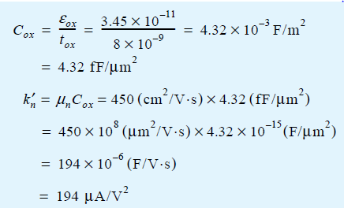
Example 1 - Sol
(a)

Slide 31
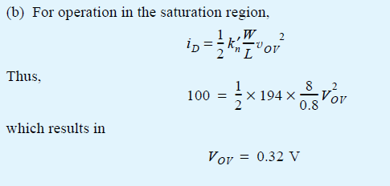
Example 1 – Sol, Cont.

Slide 32
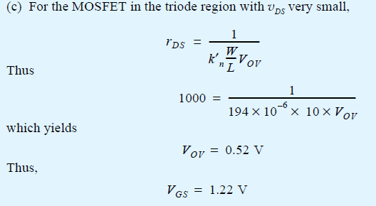
Example 1 – Sol, Cont.

Slide 33
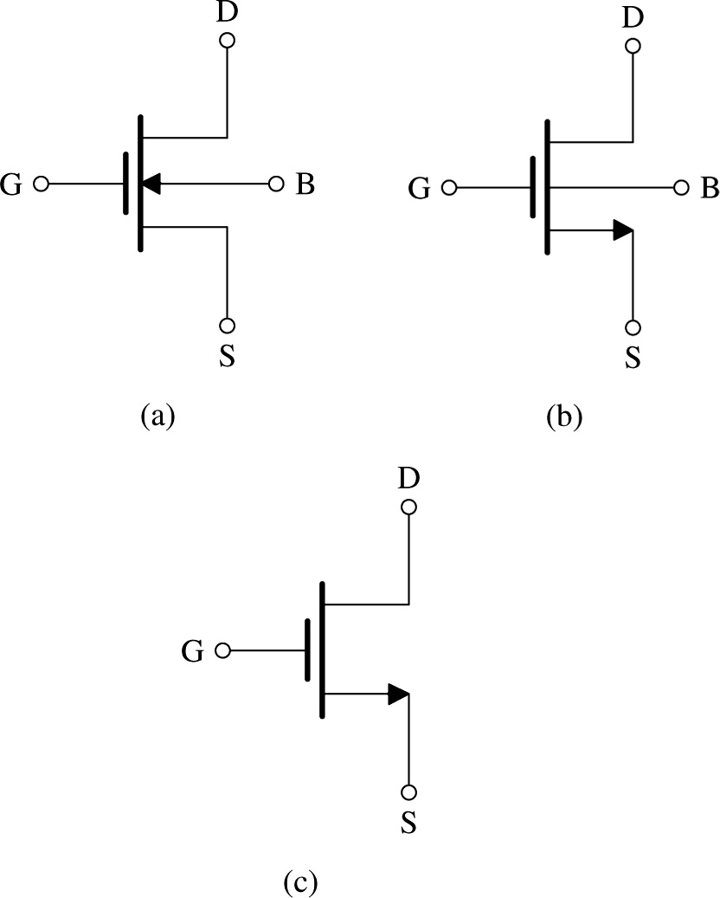
2. Current-Voltage Characteristics of MOSFET
Figure 11. shows an n-channel enhancement MOSFET.
There are four terminals:
drain (D), gate (G), body (B), and source (S).
Although, it is assumed that body and source are connected.
Figure 5 (a): Circuit symbol for the n-channel enhancement-type MOSFET. (b) Modified circuit symbol with an arrowhead on the source terminal to distinguish it from the drain and to indicate device polarity (i.e., n channel). (c) Simplified circuit symbol to be used when the source is connected to the body or when the effect of the body on device operation is unimportant.
Notes:
Note that there are several different circuit symbols used for MOSFETs. The symbol used for P-Channel MOSFETs in Multisim causes much confusion.

Slide 34
2. Current-Voltage Characteristics
Although MOSFET is symmetrical device, one often designates terminals as source and drain.
Q: How does one make this designation?
A: By polarity of voltage applied.
Arrowheads designate “normal” direction of current flow
Note that, in part (b), we designate current as D→S.
No need to place arrow with B.
the potential at drain (v_{D}) is always positive with respect to source (v_{S})
Figure 6 (a): Circuit symbol for the n-channel enhancement-type MOSFET. (b) Modified circuit symbol with an arrowhead on the source terminal to distinguish it from the drain and to indicate device polarity (i.e., n channel). (c) Simplified circuit symbol to be used when the source is connected to the body or when the effect of the body on device operation is unimportant.
Notes:
The “symmetry” is not quite true for commercially available devices due to connection from the substrate to the source. They do not wok when upside down.

Slide 35
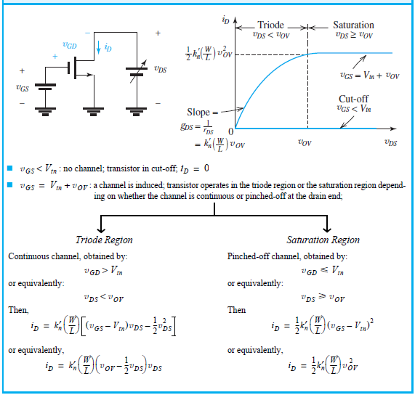
2.2. The i_{D}-v_{DS} Characteristics
Table 1. provides a compilation of the conditions and formulas for operation of NMOS transistor in three regions.
cutoff
triode
saturation

Slide 36
Table 1

Slide 37
2.2. The i_{D}-v_{DS} Characteristics
At top of table, it shows circuit consisting of NMOS transistor and two dc supplies (v_{DS}, v_{GS})
This circuit is used to demonstrate i_{D}-v_{DS} characteristic
1st set v_{GS} to desired constant
2nd vary v_{DS}
Two curves are shown…
v_{GS} < V_{tn}
v_{GS} = V_{tn} + v_{OV}

Slide 38
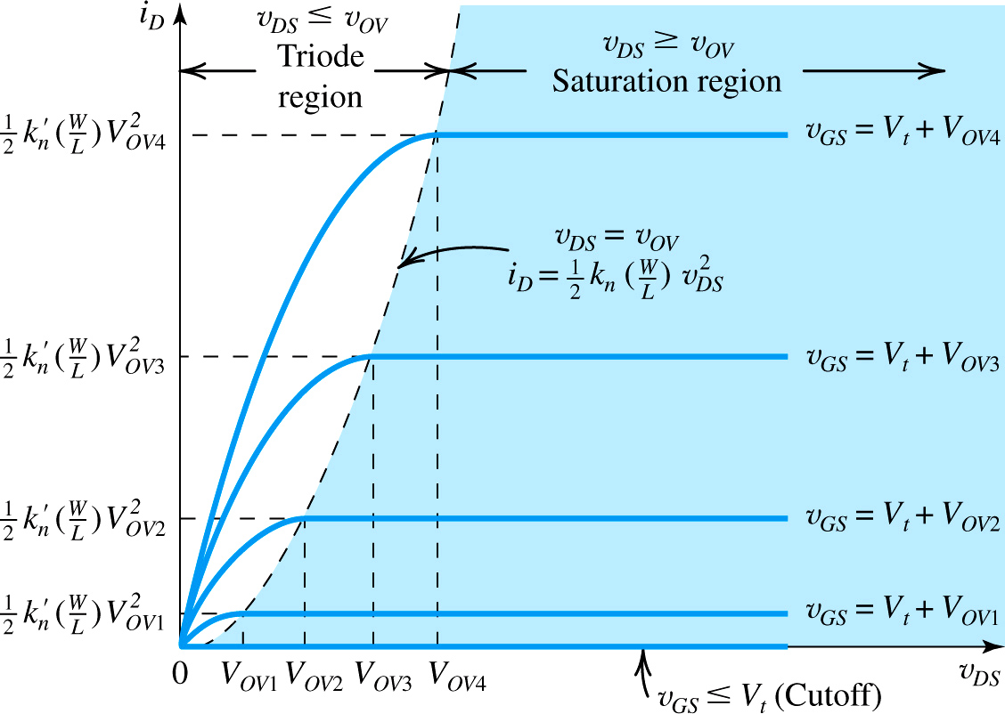
equation (7)
as v_{GS} increases, so do the (1) saturation current and (2) beginning of the saturation region
Figure 7: The i_{D} – v_{DS} characteristics for an enhancement-type NMOS transistor
Notes:
Add a “Load Line” to find the Quiescent point.

Slide 39
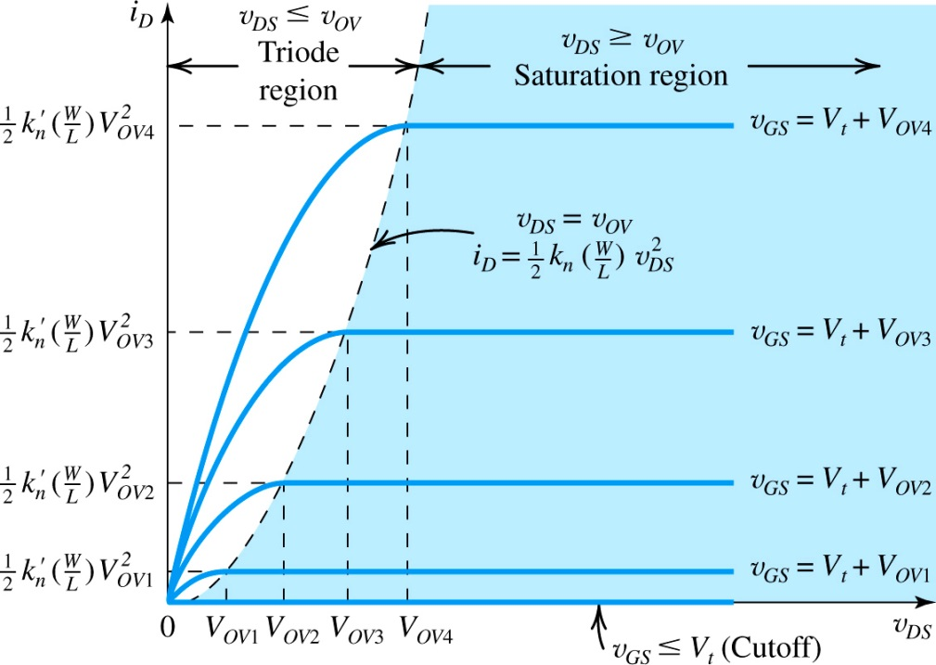
2.2. The i_{D}-v_{GS} Characteristic (Transfer Ch/s)
Q: When MOSFET’s are employed to design amplifier, in what range will they be operated?
A: saturation
In saturation, the drain current (i_{D}) is…
dependent on v_{GS}
independent of v_{DS}
In effect, it becomes a voltage-controlled current source.
This is key for amplification.
Figure 8: The i_{D} – v_{DS} characteristics for an enhancement-type NMOS transistor

Slide 40
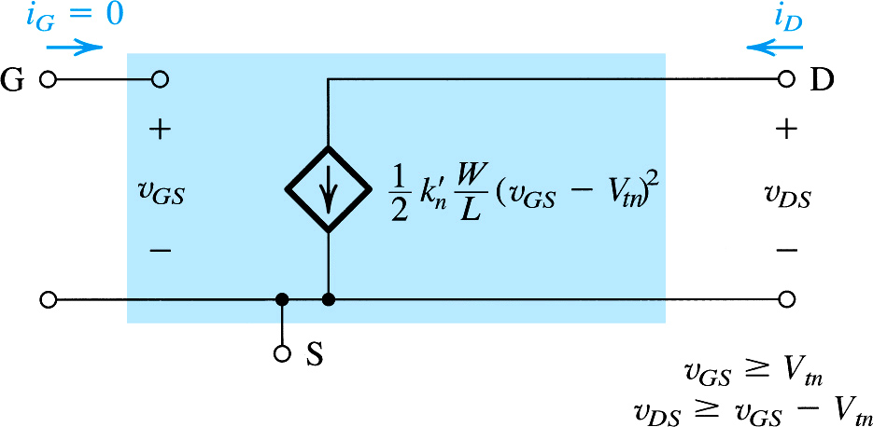
2.2. The i_{D}-v_{GS} Characteristic
The view of transistor as VCCS is exemplified in figure 15.
This circuit is known as the large-signal equivalent circuit.
Current source is ideal.
Infinite output resistance represents independent, in saturation, of i_{D} from v_{DS}..
Figure 10: Large-signal equivalent-circuit model of an n-channel MOSFET operating in the saturation

Slide 41
Example 2: NMOS Transistor
Example 5.2. Problem Statement: Consider an NMOS transistor fabricated in an 0.18-mm process with L = 0.18mm and W = 2mm. The process technology is specified to have C_{ox} = 8.6fF/mm², μ_{n} = 450cm²/Vs, and V_{tn} = 0.5V.
Q(a): Find V_{GS} and V_{DS} that result in the MOSFET operating at the edge of saturation with ID = 100mA.
Q(b): If V_{GS} is kept constant, find V_{DS} that results in I_{D} = 50mA.
Q(c): To investigate the use of the MOSFET as a linear amplifier, let it be operating in saturation with V_{DS} = 0.3V. Find the change in i_{D} resulting from v_{GS} changing from 0.7V by +0.01V and -0.01V.

Slide 42
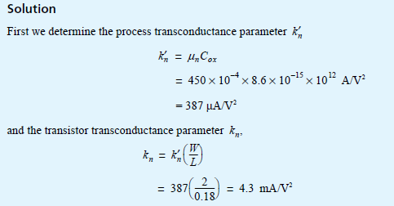
Example 2 - Sol
and since operation is at the edge of saturation,

Slide 43
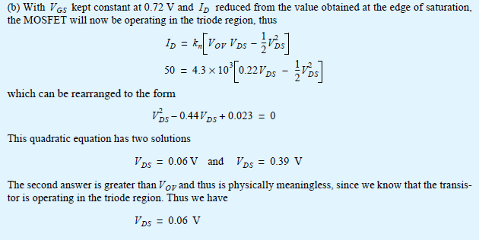
Example 2 – Sol, Cont.

Slide 44
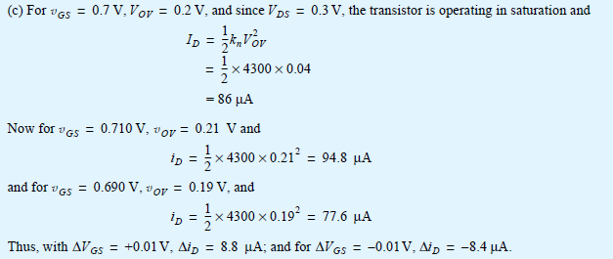
Example 2 – Sol, Cont.

Slide 45
Summary of current equations in different regions of E-MOSFET
Gate Control
If $V_{GS}>V_{t}$
If 𝑉_𝐺𝑆>𝑉_𝑡
If ($V_{DG}<{−V}_{t}$)
Triode region
$$I_{D}=k\left[{(V}_{GS}−V_{t})V_{DS}−\frac{1}{2}V_{DS}^{2}\right]$$
$$k=µ_{n}C_{ox}\left(\frac{W}{L}\right)$$
For $V_{DS}$ small (linear region)
$I_{D}=k\left[{(V}_{GS}−V_{t})V_{DS}\right]$
$$r_{DS}=\frac{V_{DS}}{I_{D}}=\frac{1}{k{(V}_{GS}−V_{t})}$$
$$\text{g}=k{(V}_{GS}−V_{t})$$
Transconductance of the channel
If (𝑉_𝐷𝐺<〖−𝑉〗_𝑡)
Triode region
𝐼_𝐷=𝑘[〖(𝑉〗_𝐺𝑆−𝑉_𝑡)𝑉_𝐷𝑆−1/2 𝑉_𝐷𝑆^2 ]
𝑘=µ_𝑛 𝐶_𝑜𝑥 (𝑊/𝐿)
For 𝑉_𝐷𝑆 small (linear region)
𝐼_𝐷=𝑘[〖(𝑉〗_𝐺𝑆−𝑉_𝑡)𝑉_𝐷𝑆 ]
𝑟_𝐷𝑆=𝑉_𝐷𝑆/𝐼_𝐷 =1/(𝑘〖(𝑉〗_𝐺𝑆−𝑉_𝑡))
"g"=𝑘〖(𝑉〗_𝐺𝑆−𝑉_𝑡)
Transconductance of the channel
If ($V_{DG}≥{−V}_{t}$)
Pinch-off region
$$I_{D}=\frac{k}{2}\left[{{(V}_{GS}−V_{t}) }^{2}\right]$$
$${\text{g}}_{m}=transconductance$$
$${\text{g}}_{m}=\frac{∂I_{D}}{∂V_{GS}}=k{(V}_{GS}−V_{t})$$
Transconductance of the amplifier
If (𝑉_𝐷𝐺≥〖−𝑉〗_𝑡)
Pinch-off region
𝐼_𝐷=𝑘/2 [〖〖(𝑉〗_𝐺𝑆−𝑉_𝑡) 〗^2 ]
"g" _𝑚=𝑡𝑟𝑎𝑛𝑠𝑐𝑜𝑛𝑑𝑢𝑐𝑡𝑎𝑛𝑐𝑒
"g" _𝑚=(𝜕𝐼_𝐷)/(𝜕𝑉_𝐺𝑆 )=𝑘〖(𝑉〗_𝐺𝑆−𝑉_𝑡)
Transconductance of the amplifier
If $V_{GS}≤V_{t}$
If 𝑉_𝐺𝑆≤𝑉_𝑡
Cutoff region
$i_{D}=0$
Cutoff region
𝑖_𝐷=0

Slide 46
Summary
The enhancement-type MOSFET is current the modt widely used semiconductor device. It is the basis of CMOS technology, which is the most popular IC fabrication technology at this time. CMOS provides both n-channel (NMOS) and p-channel (PMOS) transistors, which increases design flexibility. The minimum MOSFET channel length achievable with a given CMOS process is used to characterize the process
The overdrive voltage |V_{OV}| = |V_{GS}| - |V_{t}| is the key quantity that governs the operation of the MOSFET. For amplifier applications, the MOSFET must operate in the saturation region.

Slide 47
Summary
In saturation, i_{D} shows some linear dependence on v_{DS} as a result of the change in channel length. This channel-length modulation phenomenon becomes more pronounced as L decreases. It is modeled by ascribing an output resistance r_{o} = |V_{A}|/I_{D} to the MOSFET model. Although the effect of ro on the operation of discrete-circuit MOS amplifiers is small, that is not the case in IC amplifiers.
The essence of the use of MOSFET as an amplifier is that in saturation v_{GS} controls i_{D} in the manner of a voltage-controller current source. When the device is dc biased in the saturation region, a small-signal input (v_{gs}) may be amplified linearly.

